Slide 1
Intelligence Gathering
CNIT 48101
Topic
Notes:
https://academy.gns3.com/courses/101260/lectures/1477806

Slide 2

Intro
The first step to hacking is to gather intelligence on the target.
This chapter will overview several Python tools for gathering intelligence

Slide 3

Problems with Web Code
In this chapter, we will be dealing with a lot of web applications. We might want to make many different calls to the remote server and do some processing on the results
Normally, we would make a call to the server, pause execution and wait for the results before we do any more computation
This is really slow

Slide 4
Asynchronous and Parallel processing
Luckily, Python provides us with several libraries to make this execution faster
Asynchronous: code doesn’t wait for a process to complete. It calls the process and executes other code in the meantime
asyncio: Python library for defining asynchronous functions.
Threading/multithreading: Multithreading is not truly multithreaded due to the Python Global Interpreter Lock. It just switches between busy and free threads.
Parallel: Multiple processes run at the same time.
Multiprocess: starts multiple processes on different CPU cores
subprocess/popen: starts processes that run in the background
We won’t go into details about each library but check the Python docs for more info

Slide 5
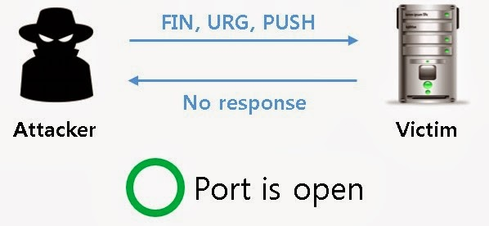
Port Scanning
Scanning for open ports helps us to determine what ports we can attack
There are several tools in Python we can use to do this:
Socket Library
Scapy
nmap

Slide 6
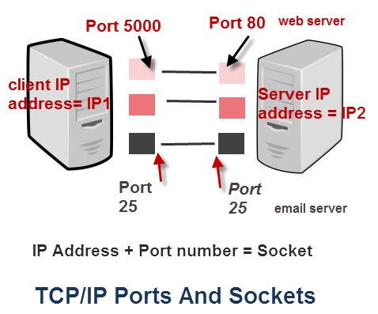
Socket Library
Library for making network sockets.
A network socket is an internal endpoint for sending or receiving data within a node on a computer network.
For our purposes, we will be using socket pair which consists of [(src ip, src port),(dst ip, dst port)]
In the following example, we preview an example of a port scanner using the Sockets library

Slide 7




Port Scanner Example
#!/usr/bin/env python
import socket
import subprocess
import sys
# Ask for input
remoteServer = raw_input("Enter a remote host to scan: ")
remoteServerIP = socket.gethostbyname(remoteServer)
# Using the range function to specify ports (here it will scans all ports between 1 and 1024)
# We also put in some error handling for catching errors
try:
for port in range(1,1025):
sock = socket.socket(socket.AF_INET, socket.SOCK_STREAM)
result = sock.connect_ex((remoteServerIP, port))
if result == 0:
print "Port {}: Open".format(port)
sock.close()
except KeyboardInterrupt:
print "You pressed Ctrl+C"
sys.exit()
except socket.gaierror:
print 'Hostname could not be resolved. Exiting'
sys.exit()
except socket.error:
print "Couldn't connect to server"
sys.exit()

Slide 8
Port Scanner Example Explained
We import the socket library. We also import subprocesses so we can run
each scan in the background. Lastly, we import the sys library to take
command line arguments
We input the IP address of the remote host
We loop over the port ranges 1-1025.
Create Socket
AF_INET specifies an IPV4 socket
SOCK_STREAM specifies a stream socket
Connect to the socket with socket.connect()
print the result if successful and close the socket
Catch the errors and exit.

Slide 9


Python-nmap
Yet another library we can use is the Python nmap. Which is Python extension to the popular network scanning library nmap.
https://xael.org/norman/python/python-nmap/

Slide 10
Python-nmap
#!/usr/bin/env python
Load nmap.py module
import nmap
instantiate nmap.PortScanner object
nm = nmap.PortScanner()
scan host 127.0.0.1, ports from 22 to 443
nm.scan('127.0.0.1', '22-443')
get command line used for the scan : nmap -oX - -p 22-443 127.0.0.1
nm.command_line()
get nmap scan informations {'tcp': {'services': '22-443', 'method':'connect'}}
nm.scaninfo()
get all hosts that were scanned
nm.all_hosts()

Slide 11
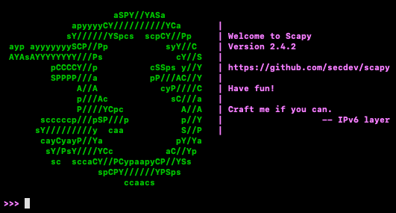
Scapy
Scapy offers us a more powerful suite of tools to do port scanning.
Allows us craft custom payloads which in turn allow us to do a wide variety of scans
The following example shows how to do a SYN scan.

Slide 12
SYN Scan
#!/usr/bin/python
import logging
logging.getLogger("scapy.runtime").setLevel(logging.ERROR)
from scapy.all import *
dst_ip = "10.0.0.1"
src_port = RandShort()
dst_port=80
tcp_connect_scan_resp = sr1(IP(dst=dst_ip)/TCP(sport=src_port,dport=dst_port,flags="S"),timeout=10)
if(str(type(tcp_connect_scan_resp))=="<type 'NoneType'>"):
print "Closed"
elif(tcp_connect_scan_resp.haslayer(TCP)):
if(tcp_connect_scan_resp.getlayer(TCP).flags == 0x12):
send_rst = sr(IP(dst=dst_ip)/TCP(sport=src_port,dport=dst_port,flags="AR"),timeout=10)
print "Open"
elif (tcp_connect_scan_resp.getlayer(TCP).flags == 0x14):
print "Closed"

Slide 13
SYN Scanner Example Explained
import the scapy library and logging library
We set the address of the remote host as 10.0.0.1
src port = random number
dst port = 80
We use the sr1() to send a packet
it will timeout in 10 seconds if no response is received
Packet has an IP field
Packet also has a TCP field
S flag denotes its a “SYN Packet”
Check the response and print the interpreted result

Slide 14
XMAS Scan
#! /usr/bin/python
import logging
logging.getLogger("scapy.runtime").setLevel(logging.ERROR)
from scapy.all import *
dst_ip = "10.0.0.1"
src_port = RandShort()
dst_port=80
xmas_scan_resp = sr1(IP(dst=dst_ip)/TCP(dport=dst_port,flags="FPU"),timeout=10)
if (str(type(xmas_scan_resp))=="<type 'NoneType'>"):
print "Open|Filtered"
elif(xmas_scan_resp.haslayer(TCP)):
if(xmas_scan_resp.getlayer(TCP).flags == 0x14):
print "Closed"
elif(xmas_scan_resp.haslayer(ICMP)):
if(int(xmas_scan_resp.getlayer(ICMP).type)==3 and int(xmas_scan_resp.getlayer(ICMP).code) in [1,2,3,9,10,13]):
print "Filtered"

Slide 15
XMAS Scan
import logging library
import scapy
set target ip as ‘10.0.01’
set src port to random number
set dst port to port 80
send packet to remote address
packet has IP field
packet has TCP field
has flags Fin Push Ack
check response and print corresponding output

Slide 16
Open Source Web Applications
A lot of web applications are powered by open source web frameworks.
Joomla
Wordpress
Apache
This means that web applications using the same frameworks share similar directory structures. We can exploit this by building crawlers to explore these common directories.
In the next example, we download a copy of an open source web framework. We then build a crawler to crawl a remote host using the local copy for reference.

Slide 17
Remote Crawler Example
import Queue
import threading
import os
import urllib2
threads = 10
target = "http://www.blackhatpython.com"
directory = "/Users/justin/Downloads/joomla-3.1.1"
filters = [".jpg",".gif",".png",".css"]
os.chdir(directory)
web_paths = Queue.Queue()
for r,d,f in os.walk("."):
for files in f:
remote_path = "%s/%s" % (r,files)
if remote_path.startswith("."):
remote_path = remote_path[1:]
if os.path.splitext(files)[1] not in filters:
web_paths.put(remote_path)

Slide 18


Remote Crawler Example (Cont.)
def test_remote():
while not web_paths.empty():
path = web_paths.get()
url = "%s%s" % (target, path)
request = urllib2.Request(url)
try:
response = urllib2.urlopen(request)
content = response.read() y
print "[%d] => %s" % (response.code,path)
response.close()
except urllib2.HTTPError as error:
#print "Failed %s" % error.code
pass
for i in range(threads):
print "Spawning thread: %d" % i
t = threading.Thread(target=test_remote)
t.start()

Slide 19
Remote Crawler Example (Cont.)
Importing Threads library for multithreading
Import queues for sharing data between threads
Import os module to manipulate file directories
import urlib2 to get open connections to urls
we set the target to blackhat.com
we set the directory to where we downloaded the web framework
we create an array of filters representing file types we don’t want to crawl
We crawl our local copy and build up a list of files we want to visit on our remote host
Only files that don’t have the extensions in our filter array are included
We add all targeted files to a Queue
os.walk(“.”) traverses all the files in “.”
note ‘r,d,f’ means root (root folder), directory (sub directory) and file

Slide 20
Remote Crawler Example (Cont.)
test_remote() function gets a file we want to visit from our Queue and tries to visit it on the remote host
we combine the file path and our target url to get the full url
we use urlopen() to try to open a connection to the remote file destination
urlopen() returns an HTTP response object
we read the response object and print the http response code
we catch any errors
We open multiple threads all running the test_remote() function
This way, we have multiple threads processing the items off our Queue

Slide 21
Black Box Web Application Testing
The last example assumed we were able to download a local copy of web framework that the target was using. This isn’t always the case and often times we will have little to no information about our target.
In this case you will want a file/word list of possible hidden resources that a web application might contain.
Use dirbuster from SVN Digger https://www.netsparker.com/blog/web-security/svn-digger-better-lists-for-forced-browsing/
In the next example, we will traverse the list of files from the wordlist and see if they exist on the remote host.

Slide 22
Black Box Directory Crawler
import urllib2
import threading
import Queue
import urllib
threads = 50
target_url = "http://testphp.vulnweb.com"
wordlist_file = "/tmp/all.txt" # from SVNDigger
user_agent = "Mozilla/5.0 (X11; Linux x86_64; rv:19.0) Gecko/20100101¬Firefox/19.0"
def build_wordlist(wordlist_file):
# read in the word list
fd = open(wordlist_file,"rb") raw_words = fd.readlines()
fd.close()
for word in raw_words:
words = Queue.Queue()
word = word.rstrip() words.put(words)
return words

Slide 23
Black Box Directory Crawler (cont.)
def dir_bruter(word_queue,extensions=None):
while not word_queue.empty():
attempt = word_queue.get()
attempt_list = []
if "." not in attempt:
attempt_list.append("/%s/" % attempt)
else:
attempt_list.append("/%s" % attempt)
if extensions:
for extension in extensions:
attempt_list.append("/%s%s" % (attempt,extension))
for brute in attempt_list:
url = "%s%s" % (target_url,urllib.quote(brute))
try:
headers = {}
headers["User-Agent"] = user_agent
r = urllib2.Request(url,headers=headers)
response = urllib2.urlopen(r)
if len(response.read()):
print "[%d] => %s" % (response.code,url)
except urllib2.URLError,e:
if hasattr(e, 'code') and e.code != 404:
print "!!! %d => %s" % (e.code,url)
pass

Slide 24
Black Box Directory Crawler (cont.)
word_queue = build_wordlist(wordlist_file)
extensions = [".php",".bak",".orig",".inc"]
for i in range(threads):
t = threading.Thread(target=dir_bruter,args=(word_queue,extensions,))
t.start()

Slide 25
Black Box Directory Crawler (cont.)
We import our urlib and urlib2 for processing urls
We import threading to multithread our program
We import Queue to share data between threads
We set the number of threads to run the program to 50
We set our target url to http://testphp.vulnweb.com
We set our directory to the wordlist file
We specify the browser we are using as Firefox
We define function to add words from a wordlist into a Queue
We open our wordlist file and read all the words in to memory
for each word in wordlist, we process it and put it to the Queue
We define a function to crawl our target based on our word queue
We take an item from the queue and set it to the attempt variable
We determine the attempt is a file or a folder and add it to our attempt list
Optionally, if we passed in an array of file extensions, we add every variations of our attempt variable with the extensions appended to it

Slide 26
Black Box Directory Crawler (cont.)
For each attempt in our attempt list, we try to open a connection
We specify our browser in the header variable
We open a connection using urlib with our specified header
We print the result and catch any errors
We build our word queue using the function from step 3
We define a list of extensions
We create 50 threads running the function from step 4 to process our word queue

Slide 27

Shodan Python
Shodan is a search engine for viewing internet connected machines.
Search networks and devices similar to your target to gather more information about your target
Shodan premium is free for students. You have to email them
comes as a cli tool as well
https://github.com/achillean/shodan-python
Installation
pip3 install shodan

Slide 28
Shodan Python example
from shodan import Shodan
api = Shodan('MY API KEY')
# Lookup an IP
ipinfo = api.host('8.8.8.8')
print(ipinfo)
# Search for websites that have been "hacked"
for banner in api.search_cursor('http.title:"hacked by"'):
print(banner)
# Get the total number of industrial control systems services on the Internet
ics_services = api.count('tag:ics')
print('Industrial Control Systems: {}'.format(ics_services['total']))

